Slide 1

Century Link weekly Governance Accounts Payable & Purchasing Risk 9th DEC’19

Slide 2
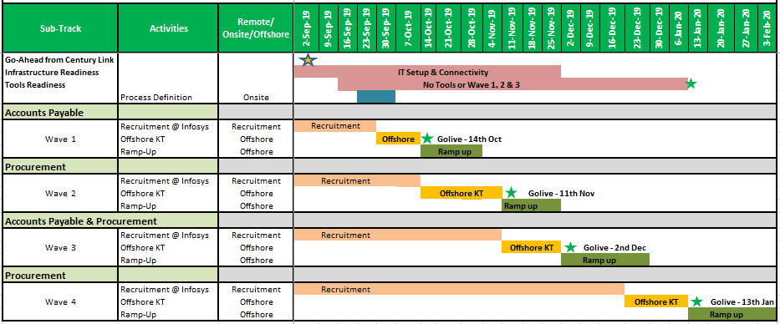
Transition plan
Year-End
Yearend
We are here

Slide 3
Program Dashboard
Program Dashboard
Current Phase
Wave 3 – Ramp up – AP
Completed / On Track Milestones
Upcoming Milestones
-
Wave 3 AP ramp up is in progress and on track
Quality framework and parameters are discussed and shared with CTL for review and approval to proceed
BCP plan for AP & PR is shared with CTL for review and approval
Focus on Wave 3 Ramp up for AP
On the Job training for new set of resources on existing variants
Project Status Summary
Last Period
This Period
Overall
G
G
Knowledge
G
G
Hiring
G
G
Technology
G
G
Top Risks / Issues / Delays
Program Level Decisions / Actions
Insidelink SAP portal access is yet to be enabled
Need open internet access to certain websites (Ex: DHL, FedEx & Commscope)
Program Team/’
Jaysin Anderson Kelly Carroll Sujatha C S Ganesan S Madhav Shanbhag Jitesh Jain Kirankumar
G
On Track
A
Potential Risk / Need Attn.
R
High Risk-High Impact / Delayed

Slide 4
Process Dashboard – Accounts Payable
Program Dashboard
Current Phase
Wave 3 – Ramp up
Completed / On Track Milestones
Wave 3 Ramp Up in progress for Vendor queries training in progress for Non PO uploads & unclaimed properties SOP’s Non-PO SOP review is setup today with Bridget Approved PO processing & Imaging SOP has been sent to Cristie & Mathew for final approval Expense SOP underway as we are waiting for some scenarios and volumes were a bit high last week Another set of resources onboarded and information shared with CTL team to initiate relevant access
Activities | Milestones
 | Offshore KT Start | Ramp up start | Go-Live
Invoice Imaging | 30th Sep’19 | 14th Oct’19 | 4th Nov’19
Invoice Processing (PO, NPO) | 11th Nov’19 | 2nd Dec’19* | 30th Dec’19
Expense Report Audit | 30th Sep’19 | 14th Oct’19 | 4th Nov’19
Vendor queries | 11th Nov’19 | 2nd Dec’19 | 30th Dec’19
Payment Processing | 11th Nov’19 | 2nd Dec’19 | 30th Dec’19
Track Status
Last Period
This Period
G
G
Project Team
Jaysin Anderson Mathews Christie Jacob Ganesan S Kirankumar Arun Mishra Naveen Pai Meenu Verma Tabrez Khan
*Existing activities will be continued and additional tasks will be added
Focus this week
Payment process training is standstill and need to start SOP/Training draft for PO Research has been shared with Jaysin. Refresher training is scheduled this week CTL to confirm on ADI tool (duplicate payment check) installation with CTL Sharepoint
Issues, Risks and/or Delays
Awaiting volumes details process wise and other requirements as shared
G
On Track
A
Potential Risk / Need Attn.
R
High Risk-High Impact / Delayed

Slide 5
Process Dashboard – Purchasing & Risk
Program Dashboard
Current Phase
Wave 2 – Gone Live
Completed / On Track Milestones
Purchasing Wave 1 has gone “Live” from 2nd Dec with 22 vendors New set of resources are undergoing OJT training with existing team Certification for the new hires are conducted and all 11 resources have passed and results are shared with Betsy New FARA template is shared with Infosys team by Richard. Infosys team is almost finalizing the resource and will be onboarded this month Last set of 6 resources onboarded and information shared with CTL team to initiate relevant access Process update on year end PO freeze shared with the team. (Team has to reject all the account assignment project P for PR, except 5 requestors)
Activities | Milestones - Wave 2
 | Offshore KT Start | Ramp up Start | Go-Live
PO Creation | 14th Oct’19 | 18th Nov’19 | 2nd Dec’19
PO Changes | 14th Oct’19 | 18th Nov’19 | 2nd Dec’19
Auxiliary Activities | 14th Oct’19 | 18th Nov’19 | 2nd Dec’19
Track Status
Last Period
This Period
G
G
Project Team
Jaysin Anderson Kelly Carroll Betsy Roark Ganesan S Kirankumar Abisheik Victor Arun Mishra Sridhar B Anindya B
Focus Next Week
Testing environment access to be provided to train the new onboarded resources Tableau access for Infosys resources (Arun & Biswas) to be enabled by CTL
Issues, Risks and/or Delays
Awaiting volumes details process wise and other requirements as shared
G
On Track
A
Potential Risk / Need Attn.
R
High Risk-High Impact / Delayed

Slide 6
OEMS Track – Accounts payable & Purchasing
Program Dashboard
Current Phase
Development
Action Items | Owner | Target Date | Expected Closure Date | Remark
Risk approval to install OEMS tool in CTL network | CTL Risk Team | 29 Nov 2019 | 30 Nov 2019 | Approval on email required
Availability of Infra for UAT environment | CTL IT | 10 Jan 2020 | TBD
Availability of Infra for Production environment | CTL IT | 10 Jan 2020 | TBD
Availability & accessibility of UAT email boxes | CTL IT | 10 Jan 2020 | TBD
Availability & accessibility of Production email boxes | CTL IT | 10 Jan 2020 | TBD
Accessibility for RM team to connect CTL OEMS Servers | CTL IT | 10 Jan 2020 | TBD
Issues, Risks and/or Delays
OEMS Servers (DB & App/Web) availability for UAT and Production before 10 Jan 2020 Mailbox creation for UAT and Prod before 10 Jan 2020. Connectivity from Infosys enterprise network
Track Status
Project Team
Sobhan – PM Angshuman – BA Lokesh - TL
Milestones | Plan | Rev. | Del.
BRD review & Sign off | 11 Nov 19 |  | 11 Nov 19
Development Kick off | 12 Nov 19 |  | 12 Nov 19
UAT Kick off | 11 Feb 19
Go-Live | 26 Feb 19
Status Last Week
BRD sign off received Development in progress
G
On Track
A
Potential Risk / Need Attn.
R
High Risk-High Impact / Delayed

Slide 7
Technology Infrastructure Track
Program Dashboard
Current Phase
Gone Live
Status Last Week
Network Connectivity – Network has been stable through this entire week
Milestones | Plan | Rev. | Del.
Bill of Material approved | 20th Sep |  | 20th Sep
Purchasing start | 20th Sep |  | 20th Sep
Purchasing complete | 30th Sep |  | 30th Sep
Desktops Installation complete | 4th Oct |  | 4th Oct
Network connectivity (CTL dependency) / OS Setup | 18th Oct |  | 7th Nov
Technology Go Live | 15th Nov |  | 15th Nov
Track Status
Last Period
This Period
G
G
Project Team
Sarvesh – IT Satyajit – IT Arun Mishra Kirankumar Abisheik Victor
Focus This Week
Approval on OEMS tool installation from CTL Risk/compliance team
Issues, Risks and/or Delays
G
On Track
A
Potential Risk / Need Attn.
R
High Risk-High Impact / Delayed

Slide 8
Thank you!

Slide 9

Infosys Organization Structure
Sujatha CS
AVP & Sr, Service Head, Client Operations
Jitesh Jain
Client Partner
Infosys Management Team
Ganesan Subramanian
Client Operations Head
Meenu Verma & Tabrez Khan
Domain Consultants - AP
CTL Dedicated Team
Sridhar & Anindya
Domain Consultants - PR
Arun Mishra
Sr. Operations Manager
Naveen Pai
Assistant Manager
(Accounts Payable)
Biswasanti Mohanty
Assistant Manager
(Purchasing)
TBD
Team Lead
(Accounts Payable)
Non-PO Invoice Processing
(12 members)
Expense Report Auditing
(5 members)
Other Activities
(3 members)
Rajesh T K
Team Lead
(Purchasing)
Purchasing
(12 members)
Suven Raj Mahapatro
Team Lead
(Purchasing)
Purchasing
(12 members)
TBD
Team Lead
(Accounts Payable)
Image Validation
(8 members)
PO Invoice Processing
(6 members)
PO Issue Resolution
(3 members)
TBD
Team Lead
(FARA)
* TBD: to be decided

